Slide 1
F
I
R
S
T
C
O
R
N
A
N
I
T
H
I
S
15.1-19
A free CD of this message will be available following the service
It will also be available for podcast later this week at calvaryokc.com

Slide 2
“Darn it!” Whack!
Whack! “Darn it!”
O
A
N
S
15.1-19
I
I
F
I
R
S
T
C
R
N
T
H

Slide 3
Eccl. 7.2 - (It is) Better to go to the house of mourning
Than to go to the house of feasting,
For that is the end of all men;
And the living will take it to heart.
O
A
N
S
15.1-19
I
I
F
I
R
S
T
C
R
N
T
H

Slide 4
Gospel - euangellizō – Good news
Literally, The gospel which I gospelized to you
Vain - from a word meaning without strength
O
A
N
S
15.1-19
I
I
F
I
R
S
T
C
R
N
T
H

Slide 5
All events in history have evidence
… None have proof
O
A
N
S
15.1-19
I
I
F
I
R
S
T
C
R
N
T
H

Slide 6
Evidence for the resurrection:
#1 – The Corinthian church
#2 – The Old Testament
#3 – Cephas (Peter)
O
A
N
S
15.1-19
I
I
F
I
R
S
T
C
R
N
T
H

Slide 7
Feast of firstfruits - Lev. 23.9-14
14th Nisan - Passover
Following Sabbath – Saturday (“High Sabbath”)
Following day - Sunday
MON
TUE
WED
THR
FRI
SAT
SUN
THE DAY Jesus rose from the dead
O
A
N
S
15.1-19
I
I
F
I
R
S
T
C
R
N
T
H

Slide 8
Ps. 16.10 - For You will not leave my soul in Sheol, Nor will You allow Your Holy One to see corruption.
O
A
N
S
15.1-19
I
I
F
I
R
S
T
C
R
N
T
H

Slide 9
Heb. 11.17-19 - ¹⁷ By faith Abraham, when he was tested, offered up Isaac, and he who had received the promises offered up his only begotten son, ¹⁸ of whom it was said, “In Isaac your seed shall be called,”
O
A
N
S
15.1-19
I
I
F
I
R
S
T
C
R
N
T
H

Slide 10
¹⁹ concluding that God was able to raise him up, even from the dead, from which he also received him in a figurative sense.
O
A
N
S
15.1-19
I
I
F
I
R
S
T
C
R
N
T
H

Slide 11
Evidence for the resurrection:
#1 – The Corinthian church
#2 – The Old Testament
#3 – Cephas (Peter)
#4 – The Twelve apostles
#5 – Over 500 eye witnesses
O
A
N
S
15.1-19
I
I
F
I
R
S
T
C
R
N
T
H

Slide 12
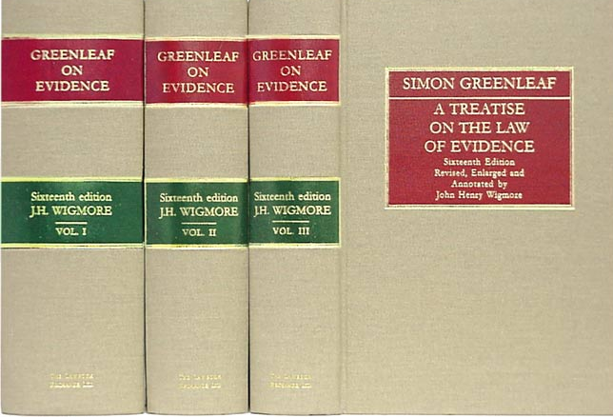
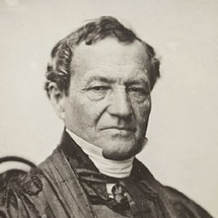
Simon Greenleaf - dean of the Harvard Law School
A Treatise on the Law of Evidence (3 vols.)
An Examination of the Four Evangel-ists examined by the Rules of Evidence Administered in the Courts of Justice
O
A
N
S
15.1-19
I
I
F
I
R
S
T
C
R
N
T
H

Slide 13
Evidence for the resurrection:
#1 – The Corinthian church
#2 – The Old Testament
#3 – Cephas (Peter)
#4 – The Twelve apostles
#5 – Over 500 eye witnesses
#6 – James, Jesus’ 1/2 brother
#7 – Paul
#8 – The other apostles
O
A
N
S
15.1-19
I
I
F
I
R
S
T
C
R
N
T
H

Slide 14
Out of due time - out + wound
Miscarriage or abortion
O
A
N
S
15.1-19
I
I
F
I
R
S
T
C
R
N
T
H

Slide 15
Luke 12.49a - For everyone to whom much is given, from him much will be required; and to whom much has been committed, of him they will ask the more.
O
A
N
S
15.1-19
I
I
F
I
R
S
T
C
R
N
T
H

Slide 16
Luke 7.47 - Therefore I say to you, her sins, which are many, are forgiven, for she loved much. But to whom little is forgiven, the same loves little.
O
A
N
S
15.1-19
I
I
F
I
R
S
T
C
R
N
T
H

Slide 17
John Locke (1632-1704) – “Our Saviour’s resurrection is truly of great importance in Christianity, so great that His being or not being the Messiah stands or falls with it.”
O
A
N
S
15.1-19
I
I
F
I
R
S
T
C
R
N
T
H

Slide 18
Gen. 1:1a - In the beginning God …
O
A
N
S
15.1-19
I
I
F
I
R
S
T
C
R
N
T
H

